Slide 1
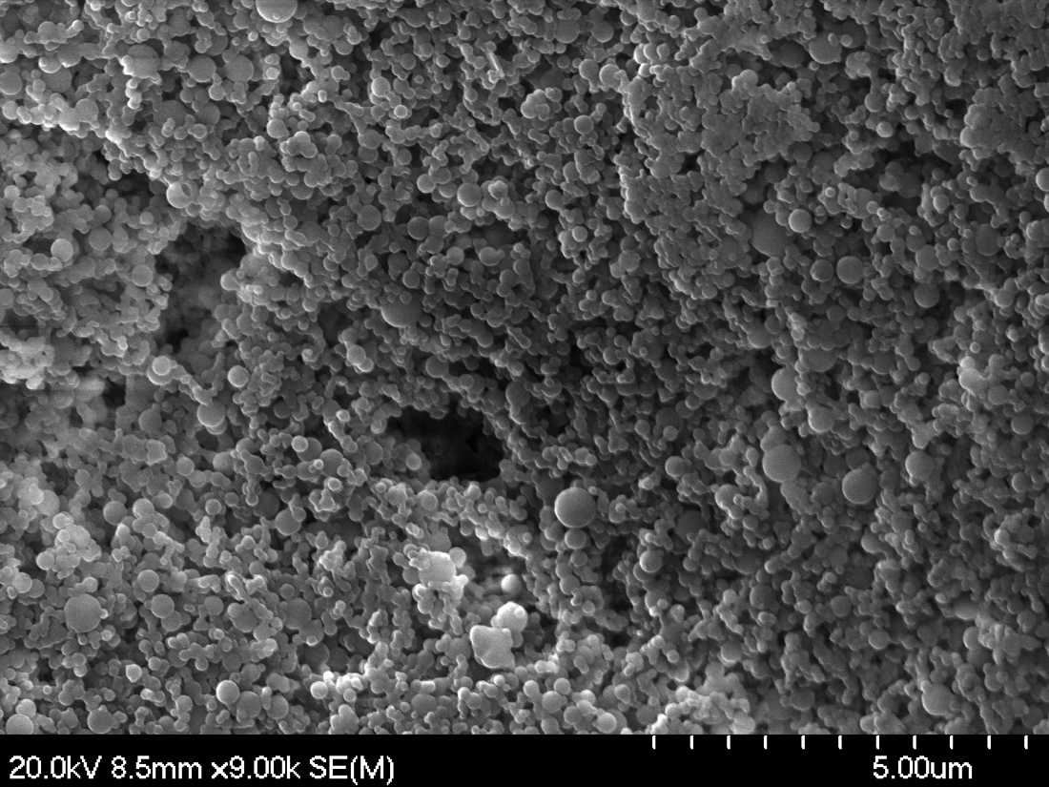
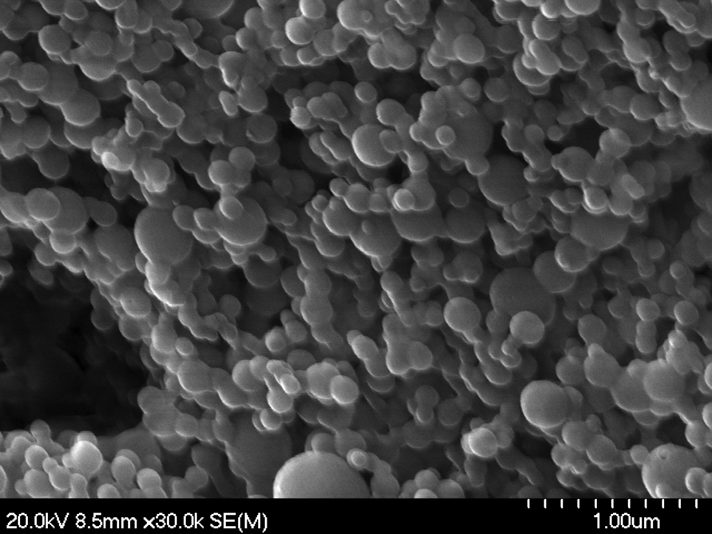
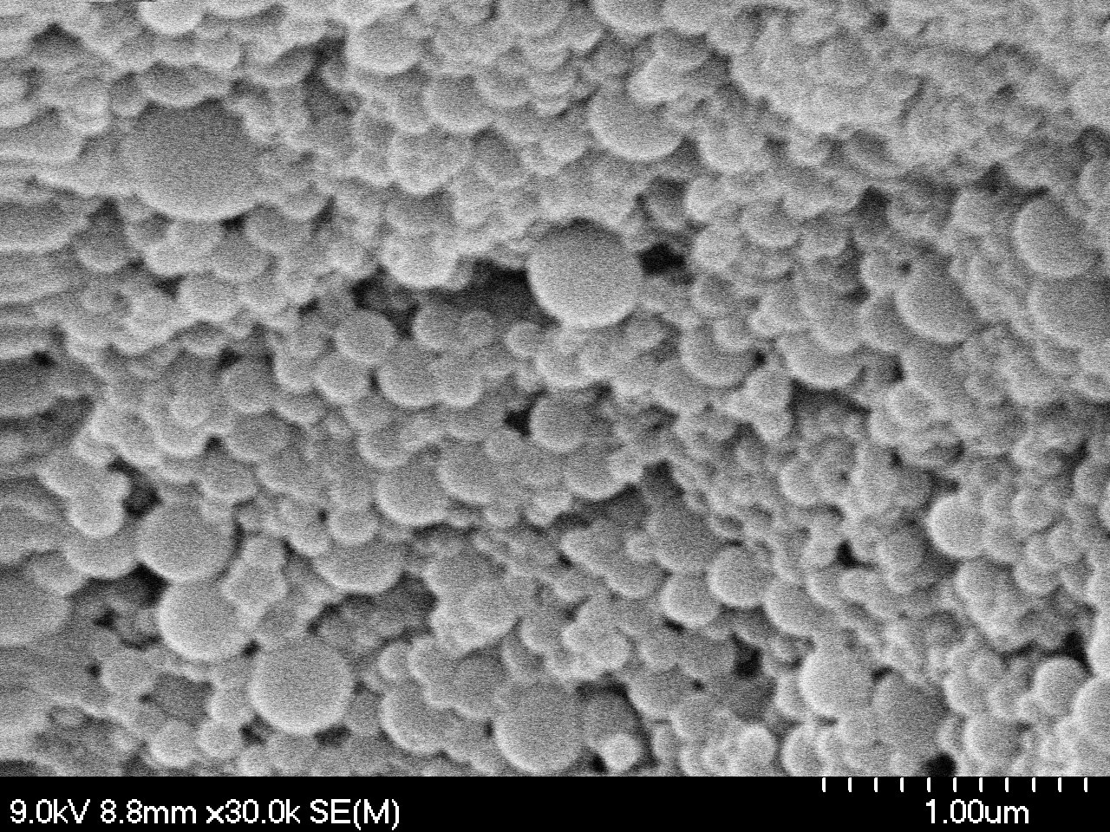
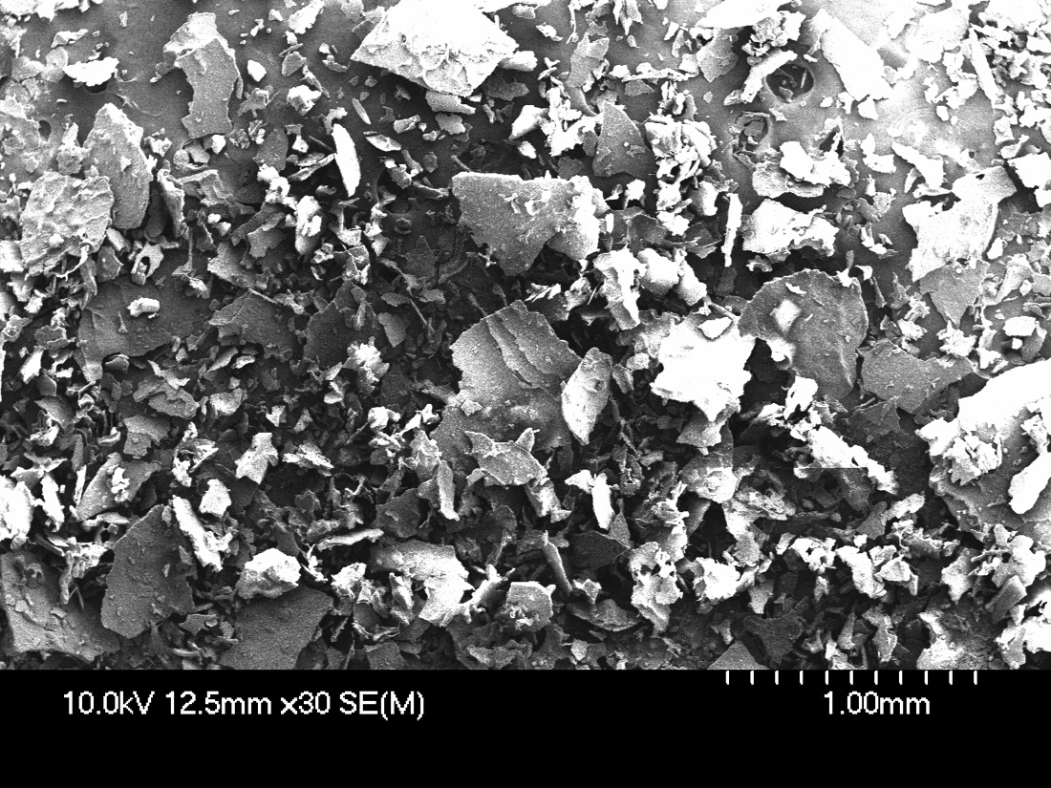
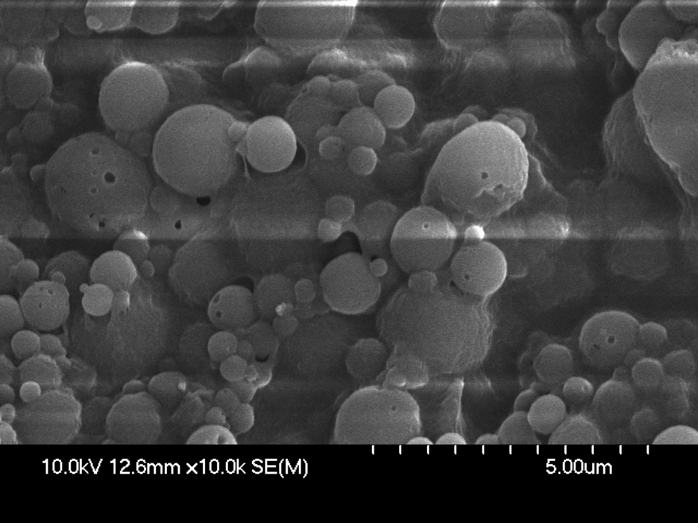
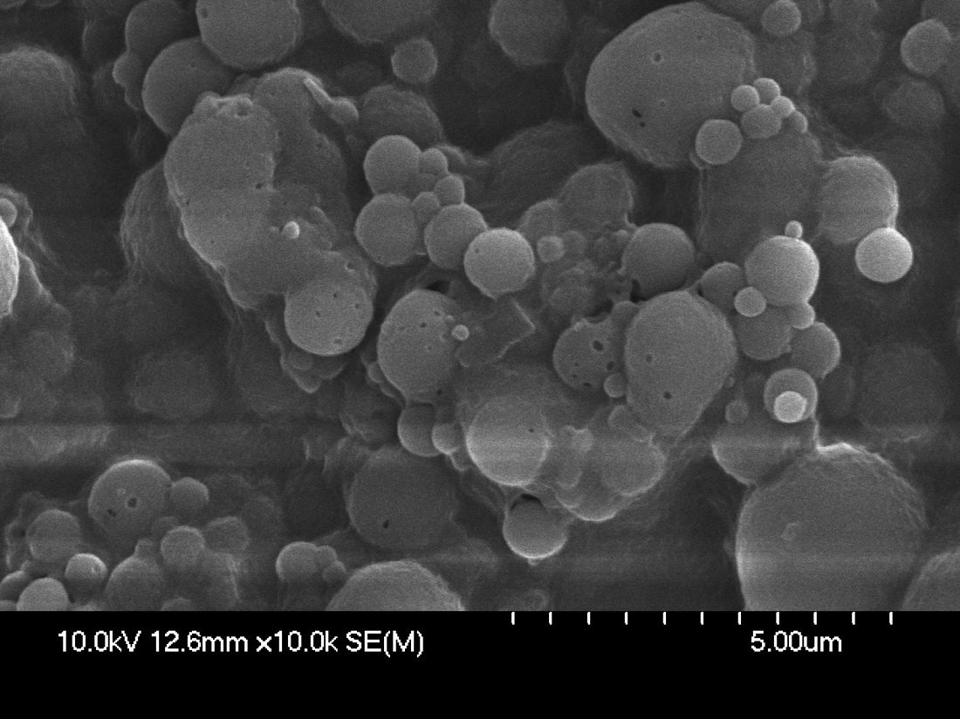
The Effects of Chitosan on Resveratrol-loaded Zein Nanoparticles
Brian Sohn
Washington University in St. Louis
Faculty Advisor: Professor Youngsoo Lee, University in Illinois in Urbana-Champaign
Introduction
Results
Results
Resveratrol is a naturally occurring polyphenolic compound showing health benefits, including anti-carcinogenic, anti-microbial, anti-HIV/AIDS, neuro-protective, and cardio-protective activities. It has been proposed as a promising dietary supplement or functional ingredient in foods to lower the prevalence of many chronic diseases. However, due to the molecule’s chemical instability, low bioavailability, and poor water solubility, its application was vastly limited. Therefore, extensive research has been conducted regarding microencapsulation of resveratrol. In this study, resveratrol was double encapsulated with zein, a prolamine protein found in maize, and chitosan, a hydrophilic, linear polysaccharide derived from chitin via a deacetylation reaction. Due to their biocompatible, biodegradable and nontoxic nature, both zein and chitosan are regarded as GRAS (Generally Recognized As Safe) materials for food applications. Many previous studies have already encapsulated resveratrol with zein and studied various properties of the nanoparticle. However, those approaches still suffer several issues such as resveratrol instability and low encapsulation efficacy. The aim of this study was to analyze the effects of an extra layer of chitosan on resveratrol-loaded zein nanoparticles.
 | Sample Size | Mean | Standard D. | Variance
Zein NPs | 3 | 126.856 nm | 11.075 | 122.661
Zein/Chitosan NPs | 3 | 86.957 nm | 8.515 | 72.510
Add your information, graphs and images to this section.
 | Encapsulation Efficiency
Zein NPs | 45.05 ± 2.22%
Zein/Chitosan NPs | 75.63 ± 5.59%
Conclusion
Scanning Electron Microscopy (SEM) images of Zein Nanoparticles (top) and Zein/Chitosan Nanoparticles (bottom)
Results from the DLS and HPLC suggest that an extra layer of chitosan on resveratrol-loaded zein nanoparticles significantly decreased the particle size and increased the encapsulation efficiency of resveratrol.
Small particle size may help increase the bioavailability of the nanoparticles.
High encapsulation efficiency may help accommodate for the compound’s key issues.
This study further highlights chitosan as a very promising coating material for microencapsulation of not only resveratrol but also potentially for various phenolic bioactive compounds.
Methodology
Preparation of Resveratrol-loaded Zein and Zein/Chitosan Nanoparticles using Antisolvent Procedure
Particle Size Measurements (DLS)
Zeta Potential Measurements (Zeta Potential Analyzer)
Scanning Electron Microscopy (SEM)
X-Ray Diffraction (XRD)
Encapsulation Efficiency Calculations using High Performance Liquid Chromatography (HPLC)
Acknowledgements
This study would not have been possible without the help of Dr. Yiming Feng and Professor Youngsoo Lee.

